Slide 1
Slide 1: Major Causes of Water Pollution in Bangladesh
Water pollution is a growing problem in Bangladesh.
It mainly happens because of human activities.
The major causes include industrial waste, agricultural runoff, oil pollution, and arsenic contamination.
These causes harm water quality, human health, and the environment.

Slide 2
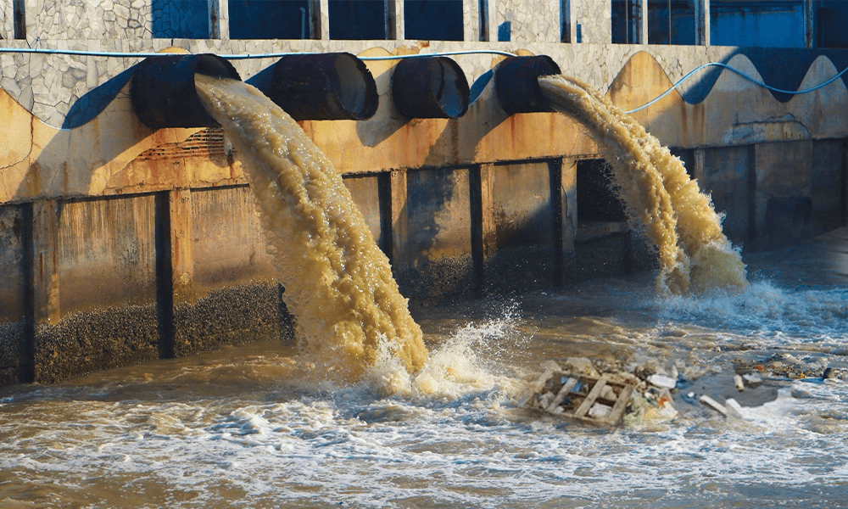
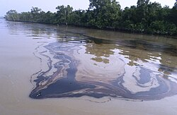

Slide 3
Industrial Waste
CAUSE
Factories release untreated chemicals, dyes, and metals into rivers.
Many industries ignore waste treatment rules.
Toxic waste makes river water dark, thick, and smelly.
Industrial areas near rivers pollute water every day.
Effect:
Fish, shrimps , and aquatic plants die in large numbers
The natural balance of the river is damaged.
People get skin diseases, infections, and allergies.
Long-term exposure can cause kidney , liver problems ,and even cancer

Slide 4
Agricultural Runoff
Cause
Farmers use large amounts of chemical fertilizers and pesticides.
Rainwater washes these chemicals into rivers and ponds.
Farmland near canals and rivers increases pollution risk.
Excess fertilizer remains in soil and slowly enters groundwater.
Effect
Fish and helpful insects die due to toxic chemicals.
Soil becomes less fertile over time
Drinking water gets polluted and unsafe.
People suffer from diarrhea, stomach pain, and other waterborne diseases

Slide 5
Oil Pollution
Cause
Oil spills from boats, ships, and launches.
Leakage from engines and fuel tanks mixes with water.
Ports and coastal areas face frequent oil pollution.
Oil spreads quickly and covers a large area of water surface
Effect
Sunlight cannot enter the water properly.
Oxygen levels drop, harming aquatic life
Fish, birds, and plants die due to lack of oxygen.
The water becomes unsafe for fishing, bathing, and daily use.

Slide 6
Arsenic Contamination
Cause
Arsenic naturally comes from underground rocks.
It mixes with groundwater used in tube-wells.
Many rural areas use deep tube-wells without testing the water.
Lack of awareness increases the use of unsafe water.
Effect:
People get skin spots, breathing problems, and long-term illness
Arsenic can cause serious diseases like cancer.
Crops and plants absorb arsenic and grow poorly.
Villagers struggle because they rely on tube-wells daily.

Slide 7
One major cause of water pollution in Bangladesh is industrial waste. Many factories in places like Savar, Gazipur, Narayanganj, and Chattogram produce chemicals, dyes, metals, and other harmful substances every day. Instead of treating these wastes properly, many industries release them directly into nearby rivers. This untreated waste mixes with river water and makes it dirty and toxic. The water becomes black, thick, and smelly. The harmful chemicals destroy fish, shrimps, and other aquatic animals. They also damage aquatic plants and make the river lose its natural balance. When people use polluted river water for bathing or washing clothes, they suffer from skin diseases, allergies, and infections. Some chemicals are so dangerous that they can cause long-term health problems like kidney damage, liver disease, and even cancer.
Another important cause of water pollution is agricultural runoff. Farmers often use a large amount of chemical fertilizers and pesticides to grow crops. During heavy rain, these chemicals wash away from the fields and enter rivers, ponds, and canals. This polluted water harms fish, kills helpful insects, and reduces the natural fertility of the soil. It also affects drinking water sources and increases the risk of diseases like diarrhea and stomach infections.
Oil pollution is also a growing problem. Oil spills from boats, launches, and ships mix with river water and create a thick layer on the surface. This layer blocks sunlight and reduces the amount of oxygen in the water. As a result, many fish, birds, and aquatic plants die because they cannot breathe or grow properly. Oil pollution also makes river water unsafe for fishing, bathing, and other human activities.
In many areas of Bangladesh, arsenic contamination is another major cause. Arsenic naturally comes from underground rocks and mixes with groundwater. When people use arsenic-contaminated tube-well water, they suffer from skin spots, breathing problems, and serious diseases like cancer. Arsenic also harms crops and reduces food production. This makes life difficult for villagers who depend on tube-well water every day.
Thus, industrial waste, agricultural runoff, oil pollution, and arsenic contamination all contribute to severe water pollution in Bangladesh. These causes create dangerous effects on human health, aquatic life, and the natural environment, putting millions of lives at risk.

